Slide 1
Test Mockups/Scenarios
Stove & Oven Web Application

Slide 2
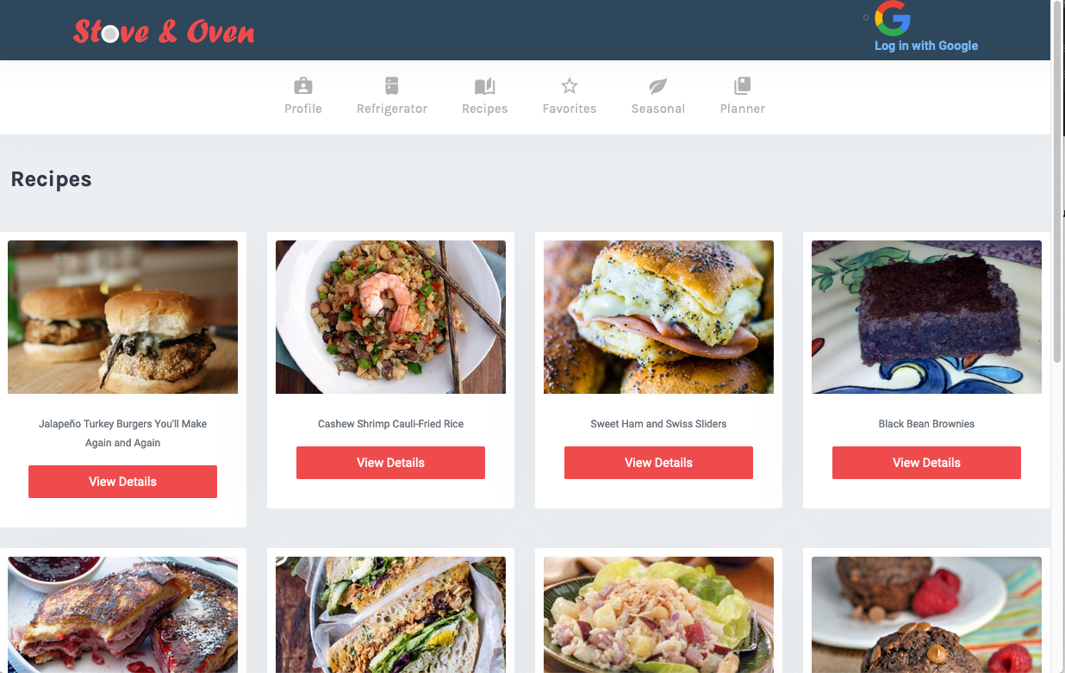
Default Page (Before Google Auth)
Non Authenticated users can view Recipes, and Details / Instructions
Default Page before Google Authentication

Slide 3
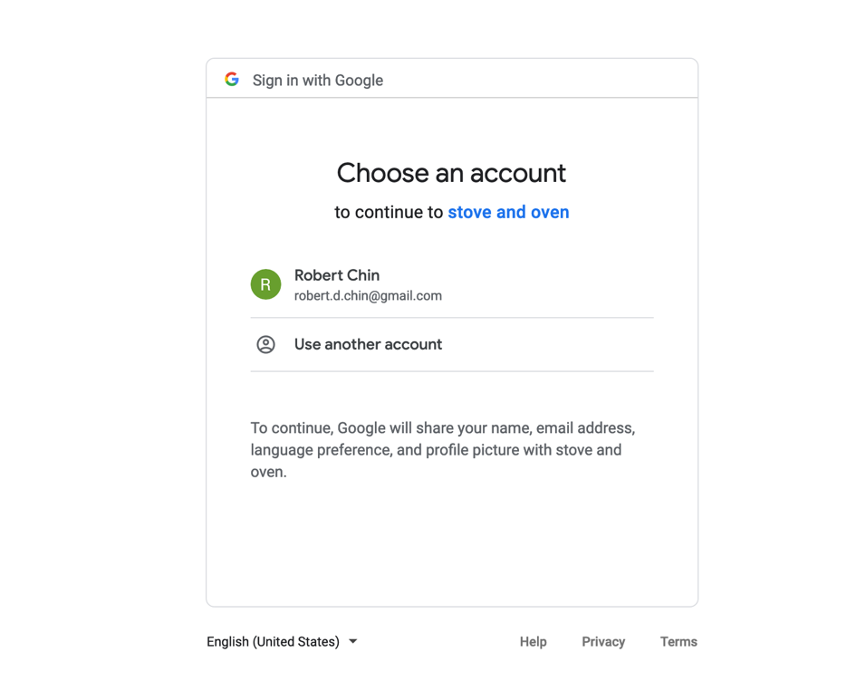
Login-2 (Google Auth)
On Login Button click, redirect to this page to Authenticate

Slide 4
Default Page (After Google Auth)
On ”Add to Planner” button push, able to select Mon-Sun to be added in to Planner
GET Recipe is already a Favorite (button won’t be there if already a favorite, or like a heart) in the Recipe Card
PUT Recipe as a Favorite to Profile
PUT Recipe to Profile’s Monday, Tues, Wed, Thurs, Fri, Sat, Sun
If Profile has a preference, display using specified filter
Otherwise, GET /api/recipes/ All

Slide 5
Profile (After Google Auth)
Profile Info:
GET googleId from Profile
GET name from Profile
GET email from Profile
GET photo from Profile
Preferences:
GET Profile Preferences, if already true don’t show button
If Profile preference already has a preference (any Vegetarian, Vegan, Gluten Free, Dairy Free, Ketogenic as true), don’t allow user to add another preference
PUT true/false for Profile preferences
DELETE true/false for Profile preferences

Slide 6
Favorites (After Google Auth)
GET User Profile’s Array of Favorites
DELETE Recipe from User Profile’s Array of Favorites (if push remove from favorites)

Slide 7
User Profile’s Refrigerator/Inventory
GET Inventory of my Profile
If inventory is empty/null, just display “Ingredients: None”
Otherwise, list them out
And the quantities/unit available
GET ALL ingredients available from Ingredients table
Should match Private Postman /api/ingredients output of JSON (i.e. acorn squash, then spice rub, then black pepper..)
On ”Add to Cart”, create “pending list” to be PUT into Inventory (they’ll show up in the right frame as they get added)
Also create a box for quantity
And display unit of measure
On “Remove from Cart”, update “pending list” to (they’ll not show up anymore in the right frame as they get removed)
On “Submit”, PUT “pending list” of Ingredients into Inventory of my Profile

Slide 8
Planner – No Recipes added into Plan Yet
GET Recipe and display Recipe Card from Profile’s Monday, Tues, Wed, Thurs, Fri, Sat, Sun, if null / no recipe currently exists display “none selected”

Slide 9
Planner – A recipe added for Monday
GET Recipe and display Recipe Card from Profile’s Monday, Tues, Wed, Thurs, Fri, Sat, Sun, if null / no recipe currently exists display “none selected”

Slide 10
Planner – Create Grocery List
At bottom of Planner page, create Grocery List
On button press “Export Grocery List”,
GET Grocery List (“Profile Inventory” against “Planner Ingredient List”), and display it
Ingredient names
Ingredient quantity and unit of measure

